Slide 1
`
INTERNATIONAL HUMAN RIGHTS COUNCIL

Slide 2
ABOUT
International Human Rights Council is one of the world’s leading independent organizations dedicated to defending and protecting human rights. By focusing international attention where human rights are violated, we give voice to the oppressed and hold oppressors accountable for their crimes. Our rigorous, objective investigations and strategic, targeted advocacy build intense pressure for action and raise the cost of human rights abuse. For years, IHRC has worked tenaciously to lay the legal and moral groundwork for deep-rooted change and has fought to bring greater justice and security to people around the world.

Slide 3
HUMAN RIGHTS
Article 1
All human beings are born free and equal in dignity and rights. They are endowed with reason and conscience and should act towards one another in a spirit of brotherhood.
Article 2
Everyone is entitled to all the rights and freedoms set forth in this Declaration, without distinction of any kind, such as race, color, sex, language, religion, political or other opinion, national or social origin, property birth or other status. Furthermore, no distinction shall be made on the basis of the political, jurisdictional or international status of the country or territory to which a person belongs, whether it be independent, trust, non-self-governing or under any other limitation of sovereignty.
Article 3
Everyone has the right to life, liberty and security of person.

Slide 4
HUMAN RIGHTS
Article 4
No one shall be held in slavery or servitude; slavery and the slave trade shall be prohibited in all their forms.
Article 5
No one shall be subjected to torture or to cruel, inhuman or degrading treatment or punishment.
Article 6
Everyone has the right to recognition everywhere as a person before the law.
Article 7
All are equal before the law and are entitled without any discrimination to equal protection of the law. All are entitled to equal protection against any discrimination in violation of this Declaration and against any incitement to such discrimination.

Slide 5
HUMAN RIGHTS
Article 8
Everyone has the right to an effective remedy by the competent national tribunals for acts violating the fundamental rights granted him by the constitution or by law.
Article 9
No one shall be subjected to arbitrary arrest, detention or exile.
Article 10
Everyone is entitled in full equality to a fair and public hearing by an independent and impartial tribunal, in the determination of his rights and obligations and of any criminal charge against him.

Slide 6
HUMAN RIGHTS
Article 11
1. Everyone charged with a penal offense has the right to be presumed innocent until proved guilty according to law in a public trial at which he has had all the guarantees necessary for his defense.
2. No one shall be held guilty of any penal offense on account of any act or omission which did not constitute a penal offense, under national or international law, at the time when it was committed. Nor shall a heavier penalty be imposed than the one that was applicable at the time the penal offense was committed.
Article 12
No one shall be subjected to arbitrary interference with his privacy, family, home or correspondence, nor to attacks upon his honor and reputation. Everyone has the right to the protection of the law against such interference or attacks.

Slide 7
HUMAN RIGHTS
Article 13
1. Everyone has the right to freedom of movement and residence within the borders of each state.
2. Everyone has the right to leave any country, including his own, and to return to his country.
Article 14
1. Everyone has the right to seek and to enjoy in other countries asylum from persecution.
2. This right may not be invoked in the case of prosecutions genuinely arising from non-political crimes or from acts contrary to the purposes and principles of the United Nations.

Slide 8
HUMAN RIGHTS
Article 15
1. Everyone has the right to a nationality.
2. No one shall be arbitrarily deprived of his nationality nor denied the right to change his nationality.
Article 16
1. Men and women of full age, without any limitation due to race, nationality or religion, have the right to marry and to found a family. They are entitled to equal rights as to marriage, during marriage and at its dissolution.
2. Marriage shall be entered into only with the free and full consent of the intending spouses.
3. The family is the natural and fundamental group unit of society and is entitled to protection by society and the State.

Slide 9
HUMAN RIGHTS
Article 17
1. Everyone has the right to own property alone as well as in association with others.
2. No one shall be arbitrarily deprived of his property.
Article 18
Everyone has the right to freedom of thought, conscience and religion; this right includes freedom to change his religion or belief, and freedom, either alone or in community with others and in public or private, to manifest his religion or belief in teaching, practice, worship and observance.
Article 19
Everyone has the right to freedom of opinion and expression; this right includes freedom to hold opinions without interference and to seek, receive and impart information and ideas through any media and regardless of frontiers.

Slide 10
HUMAN RIGHTS
Article 20
1. Everyone has the right to freedom of peaceful assembly and association.
2. No one may be compelled to belong to an association.
Article 21
1. Everyone has the right to take part in the government of his country, directly or through freely chosen representatives.
2. Everyone has the right of equal access to public service in his country.
3. The will of the people shall be the basis of the authority of government; this will shall be expressed in periodic and genuine elections which shall be by universal and equal suffrage and shall be held by secret vote or by equivalent free voting procedures.

Slide 11
HUMAN RIGHTS
Article 22
Everyone, as a member of society, has the right to social security and is entitled to realization, through national effort and international co-operation and in accordance with the organization and resources of each State, of the economic, social and cultural rights indispensable for his dignity and the free development of his personality.
Article 23
1. Everyone has the right to work, to free choice of employment, to just and favorable conditions of work and to protection against unemployment.
2. Everyone, without any discrimination, has the right to equal pay for equal work.
3. Everyone who works has the right to just and favorable remuneration ensuring for himself and his family an existence worthy of human dignity, and supplemented, if necessary, by other means of social protection.
4. Everyone has the right to form and to join trade unions for the protection of his interests.

Slide 12
HUMAN RIGHTS
Article 24
Everyone has the right to rest and leisure, including reasonable limitation of working hours and periodic holidays with pay.
Article 25
1. Everyone has the right to a standard of living adequate for the health and well-being of himself and of his family, including food, clothing, housing and medical care and necessary social services, and the right to security in the event of unemployment, sickness, disability, widowhood, old age or other lack of livelihood in circumstances beyond his control.
2. Motherhood and childhood are entitled to special care and assistance. All children, whether born in or out of wedlock, shall enjoy the same social protection.

Slide 13
HUMAN RIGHTS
Article 26
1. Everyone has the right to education. Education shall be free, at least in the elementary and fundamental stages. Elementary education shall be compulsory. Technical and professional education shall be made generally available and higher education shall be equally accessible to all on the basis of merit.
2. Education shall be directed to the full development of the human personality and to the strengthening of respect for human rights and fundamental freedoms. It shall promote understanding, tolerance and friendship among all nations, racial or religious groups, and shall further the activities of the United Nations for the maintenance of peace.
3. Parents have a prior right to choose the kind of education that shall be given to their children.

Slide 14
HUMAN RIGHTS
Article 27
Everyone has the right freely to participate in the cultural life of the community, to enjoy the arts and to share in scientific advancement and its benefits.
2. Everyone has the right to the protection of the moral and material interests resulting from any scientific, literary or artistic production of which he is the author.
Article 28
Everyone is entitled to a social and international order in which the rights and freedoms set forth in this Declaration can be fully realized.

Slide 15
HUMAN RIGHTS
Article 29
1. Everyone has duties to the community in which alone the free and full development of his personality is possible.
2. In the exercise of his rights and freedoms, everyone shall be subject only to such limitations as are determined by law solely for the purpose of securing due recognition and respect for the rights and freedoms of others and of meeting the just requirements of morality, public order and the general welfare in a democratic society.
3. These rights and freedoms may in no case be exercised contrary to the purposes and principles of the United Nations.

Slide 16
HUMAN RIGHTS
Article 30
Nothing in this Declaration may be interpreted as implying for any State, group or person any right to engage in any activity or to perform any act aimed at the destruction of any of the rights and freedoms set forth herein.
Human Rights

Slide 17
WHAT ARE HUMAN RIGHTS
Universal and inalienable
The principle of universality of human rights is the cornerstone of international human rights law. This principle, as first emphasized in the Universal Declaration on Human Rights in 1948, has been reiterated in numerous international human rights conventions, declarations, and resolutions.
Interdependent and indivisible
All human rights are indivisible, whether they are civil and political rights, such as the right to life, equality before the law and freedom of expression; economic, social and cultural rights, such as the rights to work, social security and education , or collective rights, such as the rights to development and self-determination, are indivisible, interrelated and interdependent. The improvement of one right facilitates advancement of the others. Likewise, the deprivation of one right adversely affects the others.

Slide 18
WHAT ARE HUMAN RIGHTS
Equal and non-discriminatory
Non-discrimination is a cross-cutting principle in international human rights law. The principle is present in all the major human rights treaties and provides the central theme of some of international human rights conventions such as the International Convention on the Elimination of All Forms of Racial Discrimination and the Convention on the Elimination of All Forms of Discrimination against Women.
The principle applies to everyone in relation to all human rights and freedoms and it prohibits discrimination on the basis of a list of non-exhaustive categories such as sex, race, colour and so on. The principle of non-discrimination is complemented by the principle of equality, as stated in Article 1 of the Universal Declaration of Human Rights: All human beings are born free and equal in dignity and rights.

Slide 19
WHAT ARE HUMAN RIGHTS
Both Rights and Obligations
Human rights entail both rights and obligations. States assume obligations and duties under international law to respect, to protect and to fulfill human rights. The obligation to respect means that States must refrain from interfering with or curtailing the enjoyment of human rights. The obligation to protect requires States to protect individuals and groups against human rights abuses. The obligation to fulfill means that States must take positive action to facilitate the enjoyment of basic human rights. At the individual level, while we are entitled our human rights, we should also respect the human rights of others.

Slide 20
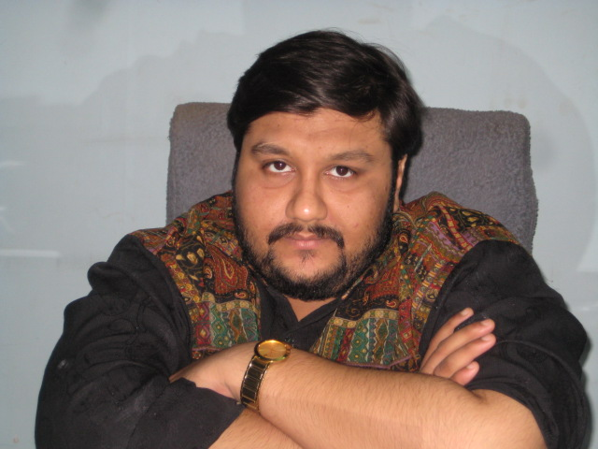
FOUNDER MESSAGE
Sunny Shah (Founder)
A very warm welcome from Mr. Shah to All Human Rights Activist of Universe, IHRC is meant to support people, help people, but not to destroy people, basically many of people acquired support of Human Rights for their Greediness, but that is not all of Human Rights, you should first understand the moral of Human Rights, it has a far destiny than caste, creed, religion, system, tradition, culture, and then last but not least community, people manipulate themselves with their own views and then pretend to desire that people should react with their thoughts, but they cant understand Human Rights is simple, they only are in needs of their benefits to fulfill from Human Rights, but no one is interested deeply to know the method and theory of rights, when you are a Human Right Activist, you itself are the justice to define the requirement of rights, Before justifying your activism think once, that you are not violating any Human Rights for the sake of community, so now you are committing a heinous crime if you do so, that means you are violating law of Human Rights,

Slide 21
WHAT ARE HUMAN RIGHTS
instead of protecting it. So please ensure and consider that you are not hurting anyone in the world, because that is the fact, that you are violating Human Rights.
And now again back to work, inventing organization was the reason to make each and every human a powerful emblem in front of world, now we classify how it was possible, yes it is possible by guiding people the awareness of their rights, teaching them fundamental laws of country and to abide them, and we should never think, that the country never runs without me, because you are here to help others, and we ensure give and take policy to return us our teachings by educating or gifting your teachings and our preaching to others who are in need of good deed. A person has two hands, one for helping himself,, the other for helping others, Service to others is a Tax you pay to live on Earth, The Measure of a Life is not its Duration but its Donation, Giving is art of Living.
“I am only one, but still I am one. I cannot do everything, but still
I can do something; and because I cannot do everything,
I will not refuse to do the something that I can do.”

Slide 22
We are working on Health among on Female Sex Workers, in Mumbai as we have 800 Female Sex workers registered with us, and in which 300 are registered with HIV positive, In which we provide Monthly Nutrition for 108 Females, who are no eligible to Purchase their Health Nutrition. And also we provide their routine check up, at Government Hospitals. After making too much initiative by Government and Various Foreign Agencies, still we think people intends to discriminate HIV Positive Patients, As our Mission is to Change Lives of these patients, so as they do not die before their death.

Slide 23
If you want to Support our Initiative, Please you are welcomed, If You go to religious place you donate generously, why because you think that donation will be paid you back, but supporting these causes will be reimburse in Heaven
Hi, here is your gate to Heaven of ₹500.00 for HIV + Donation. Make payment at
https://www.payumoney.com/merchant/billTool/#/invoicePayment?invoicePriceDetailId=7914BDEBE9DB24710DBC1D5D7CCB1260
Thanks, INTERNATIONAL HUMAN RIGHTS COUNCIL

Slide 24
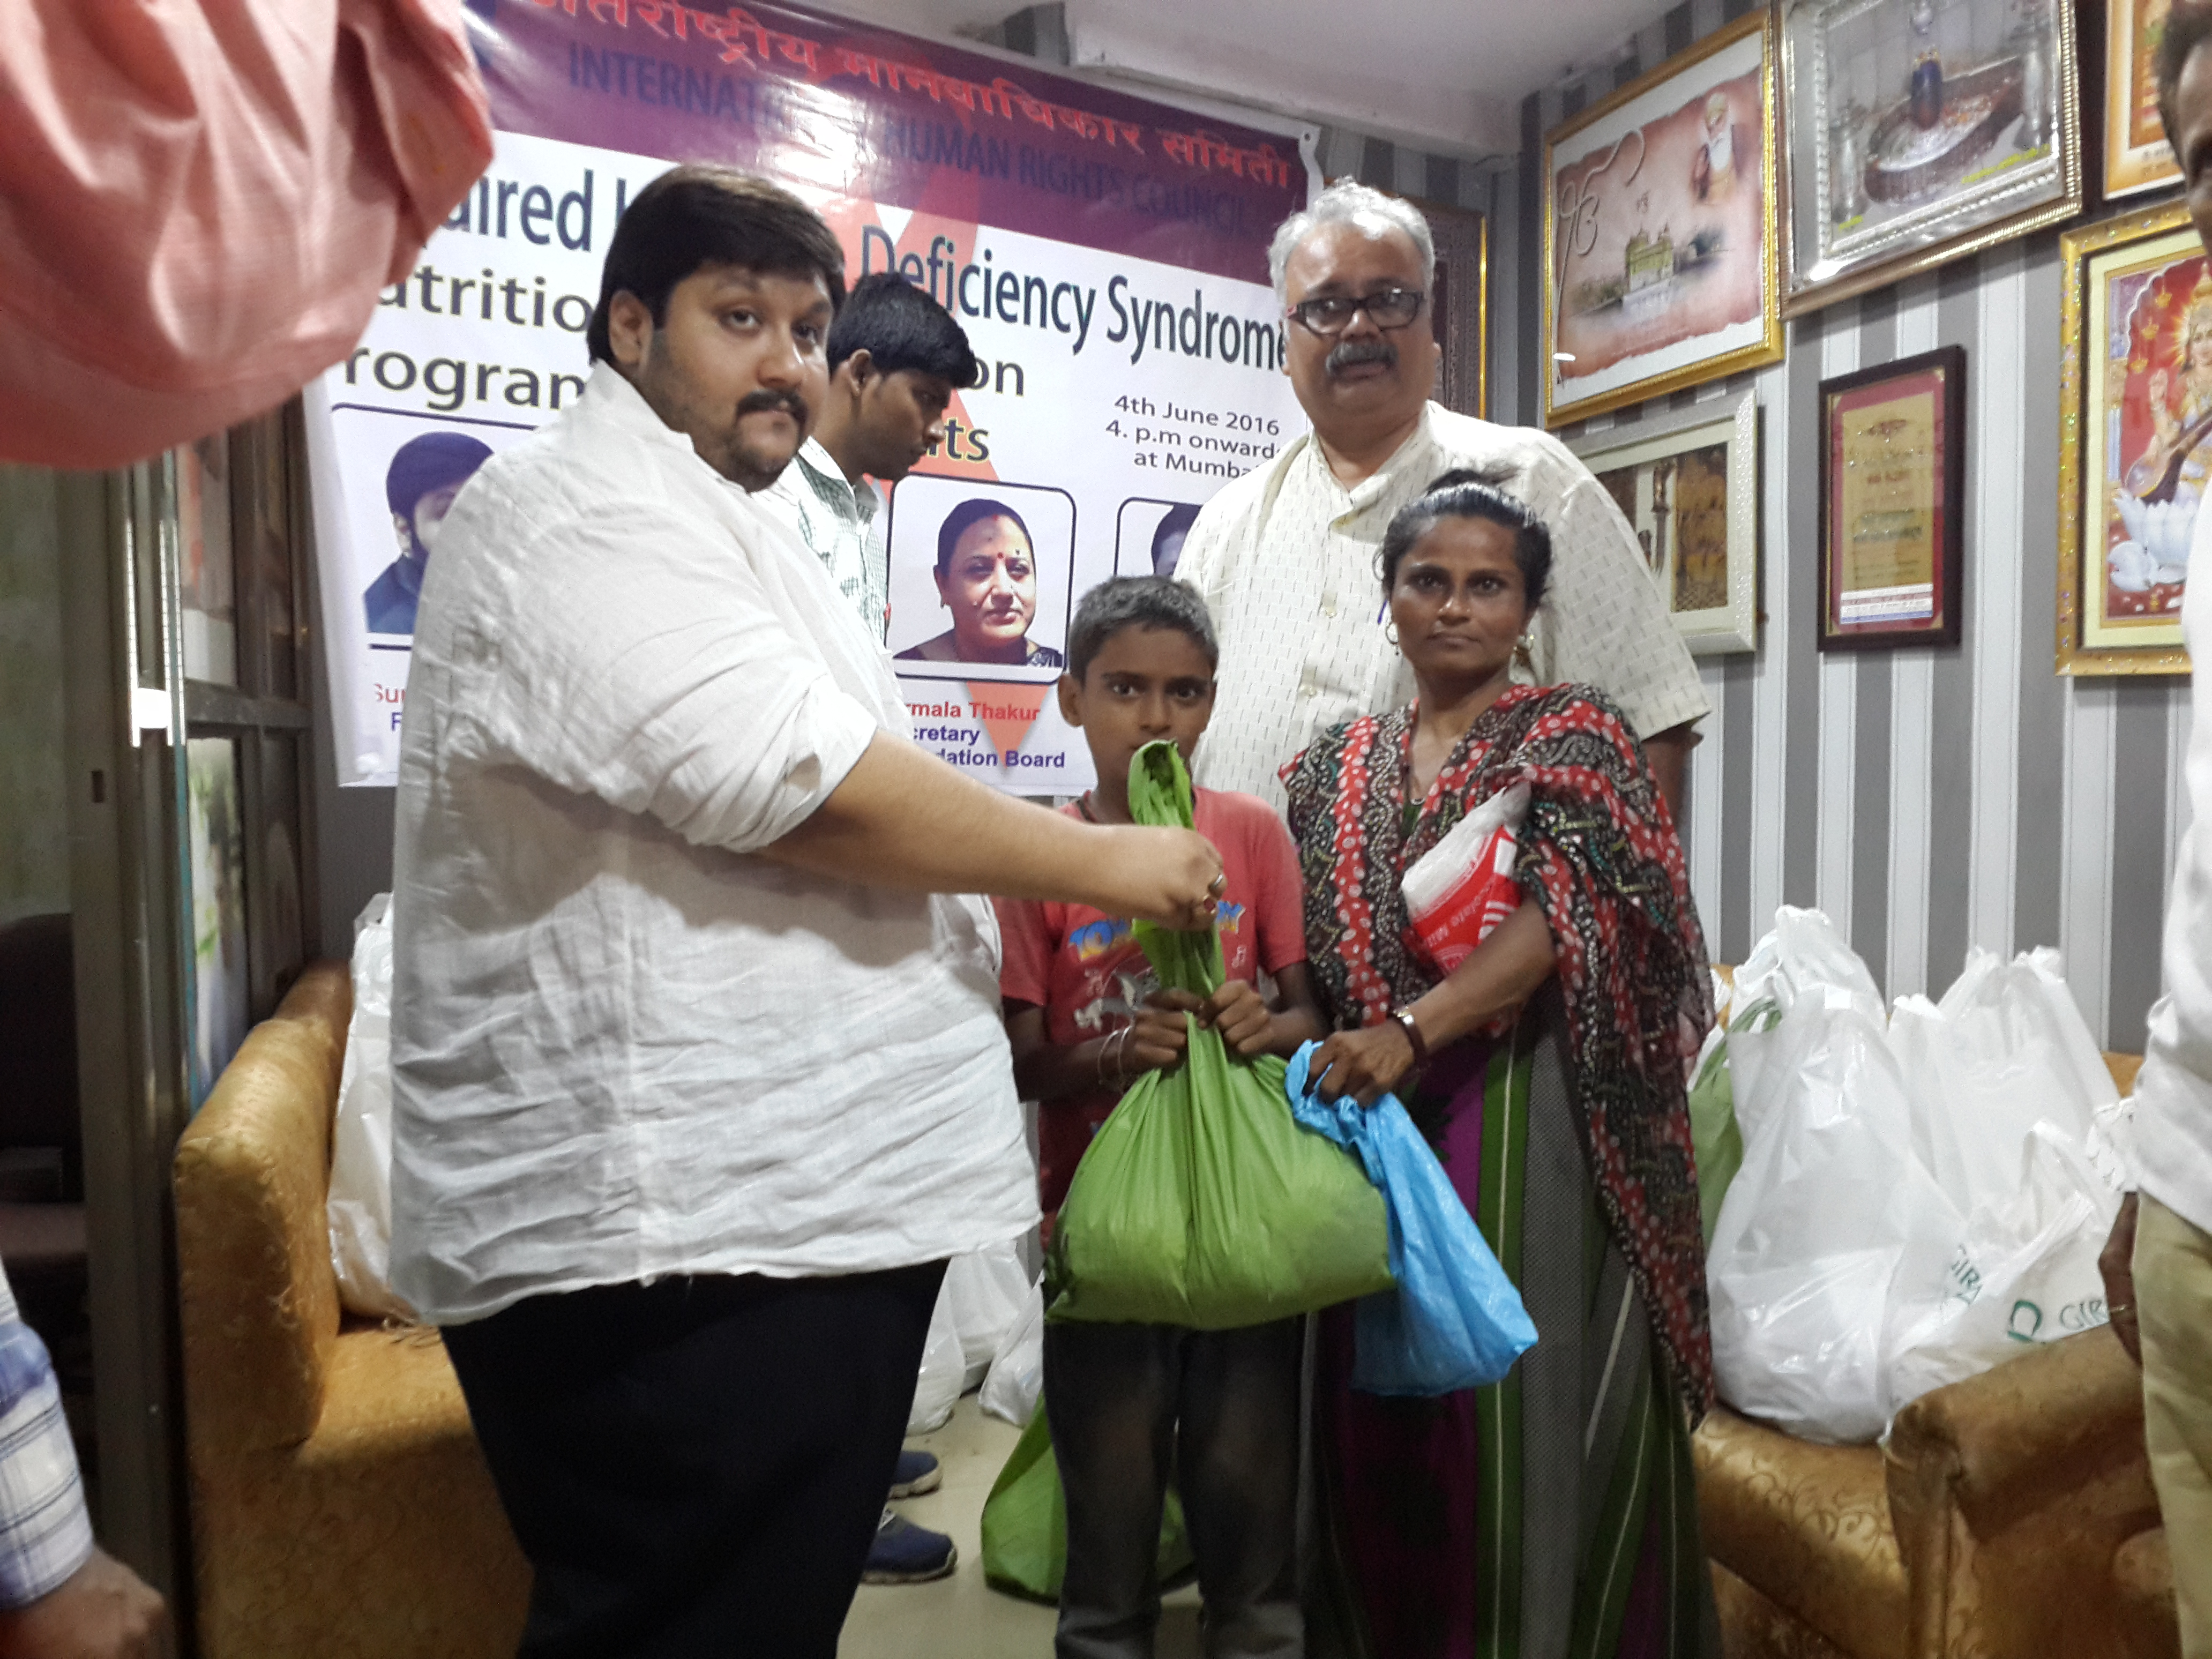

Slide 25
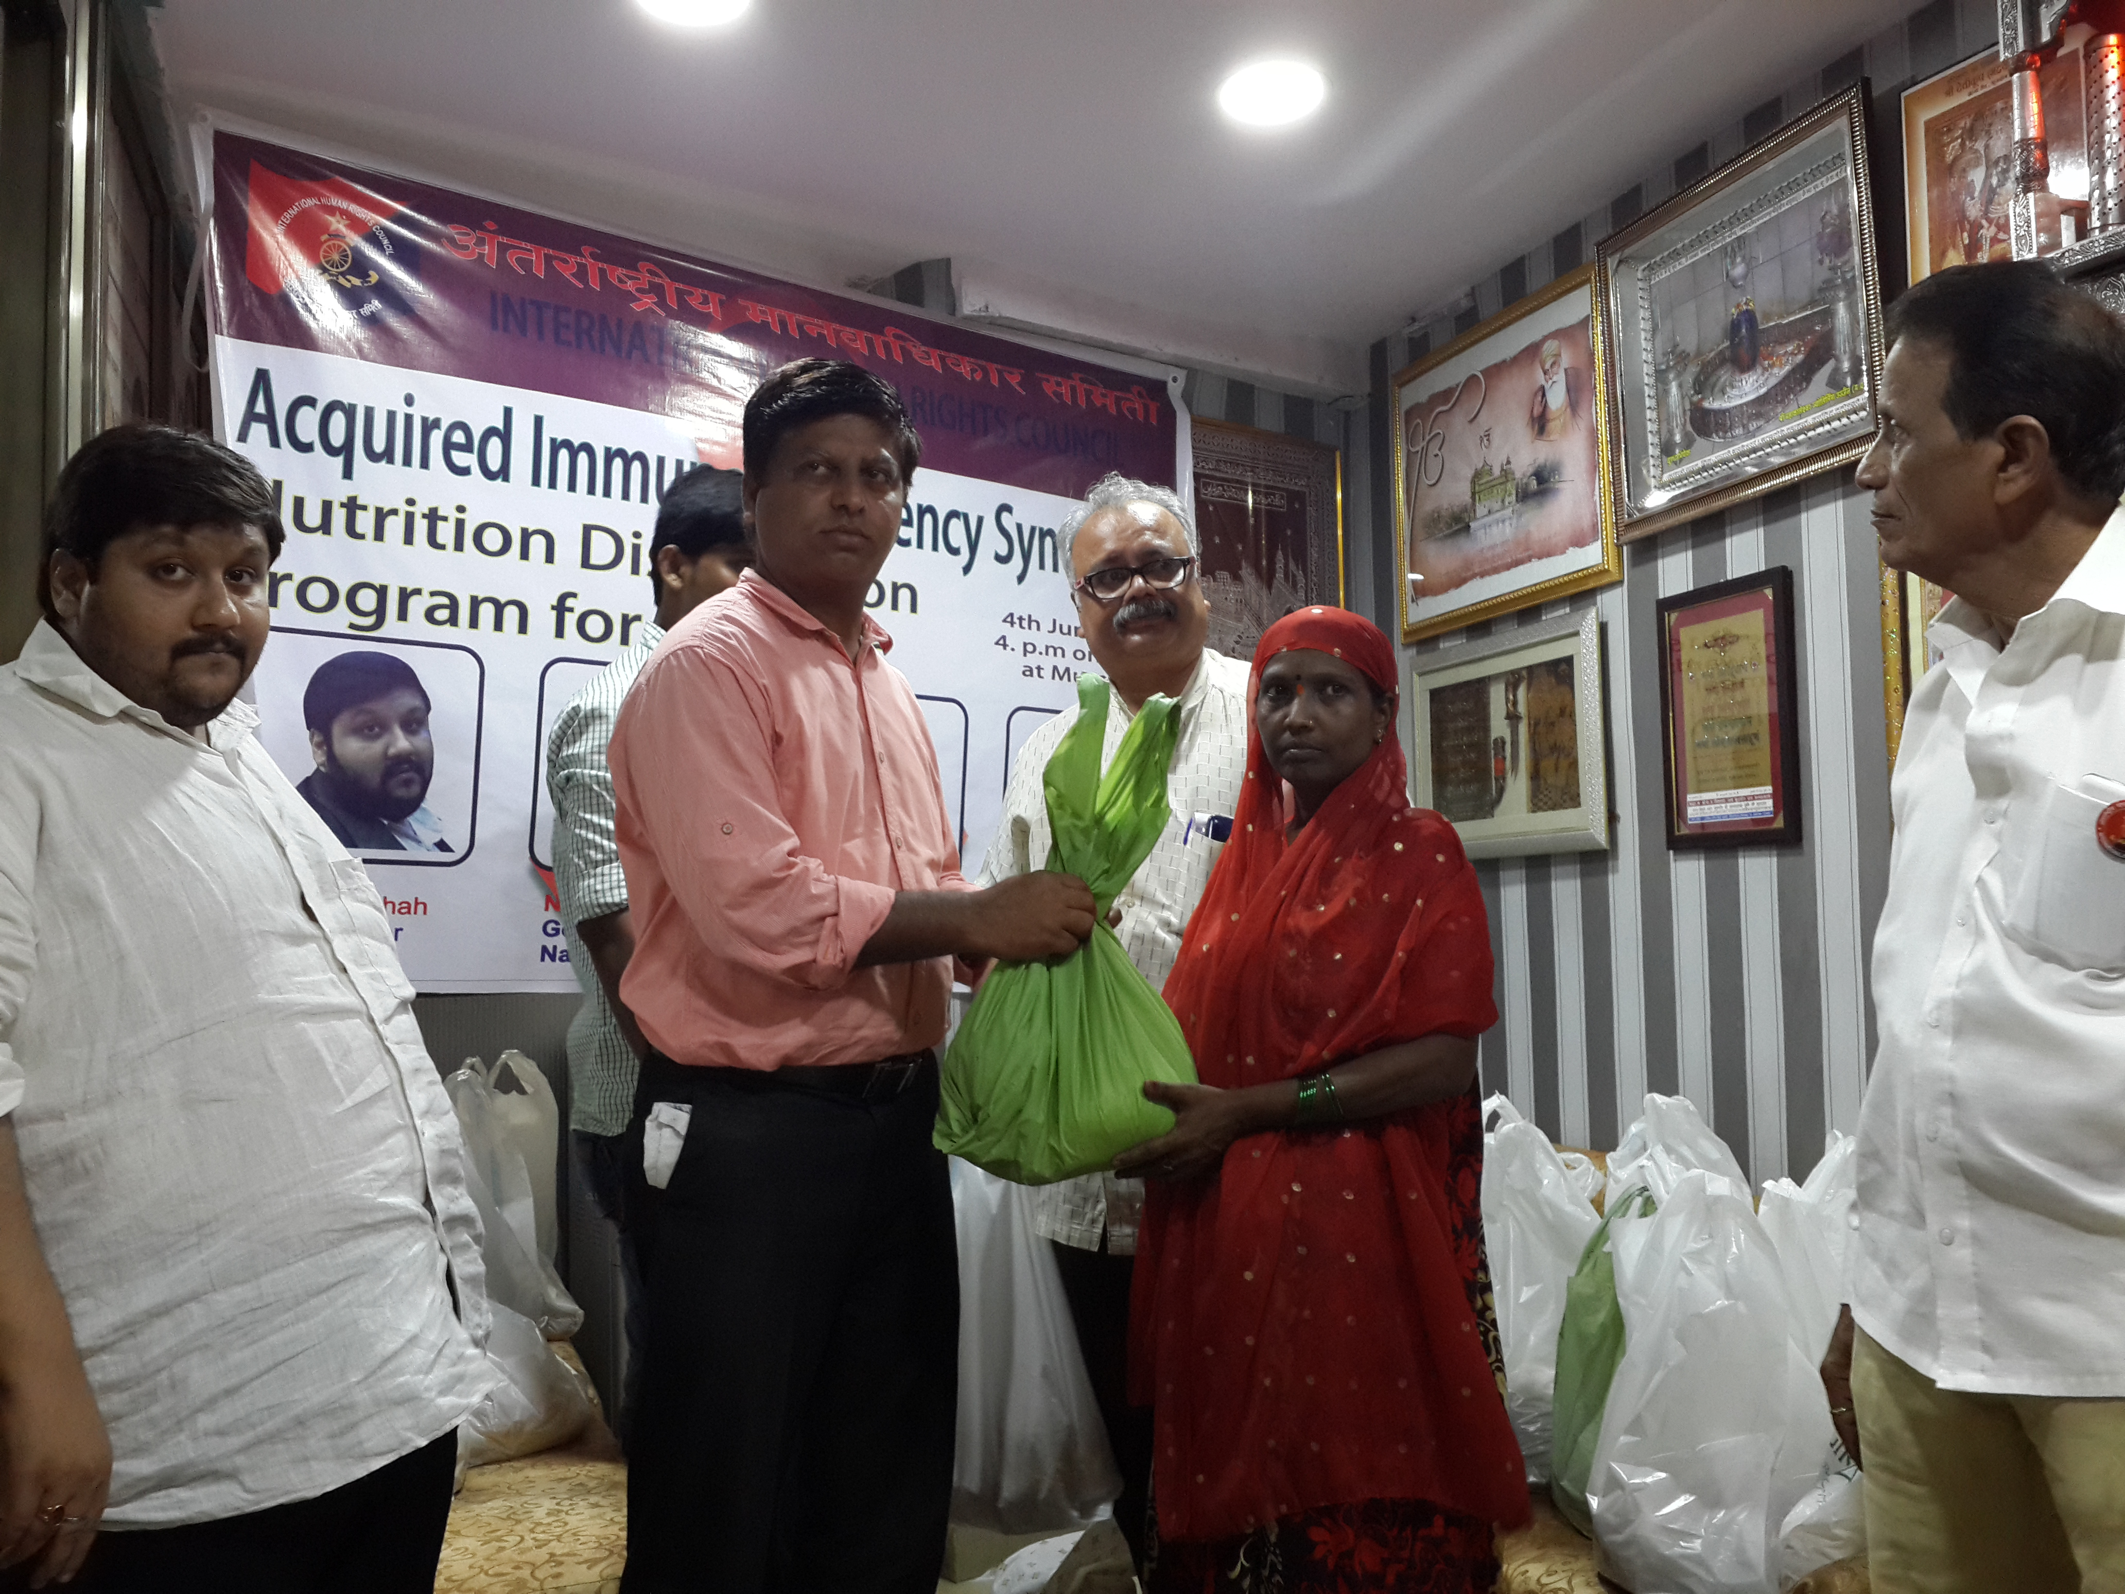

Slide 26
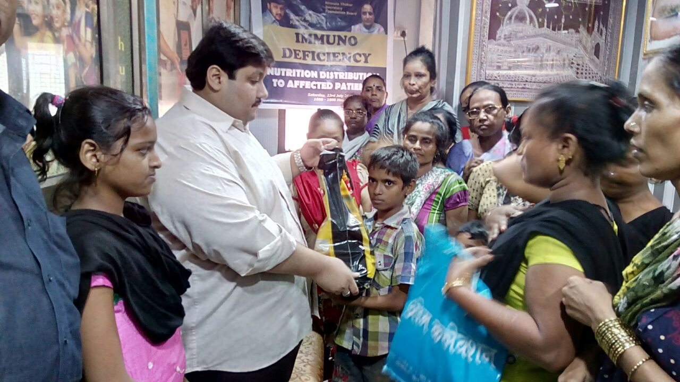

Slide 27
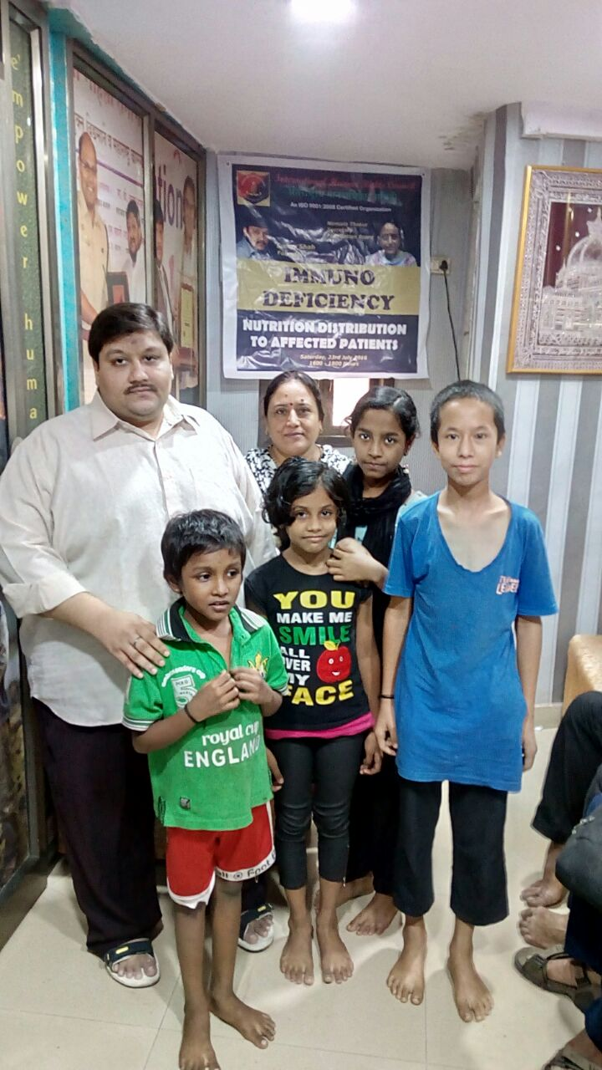
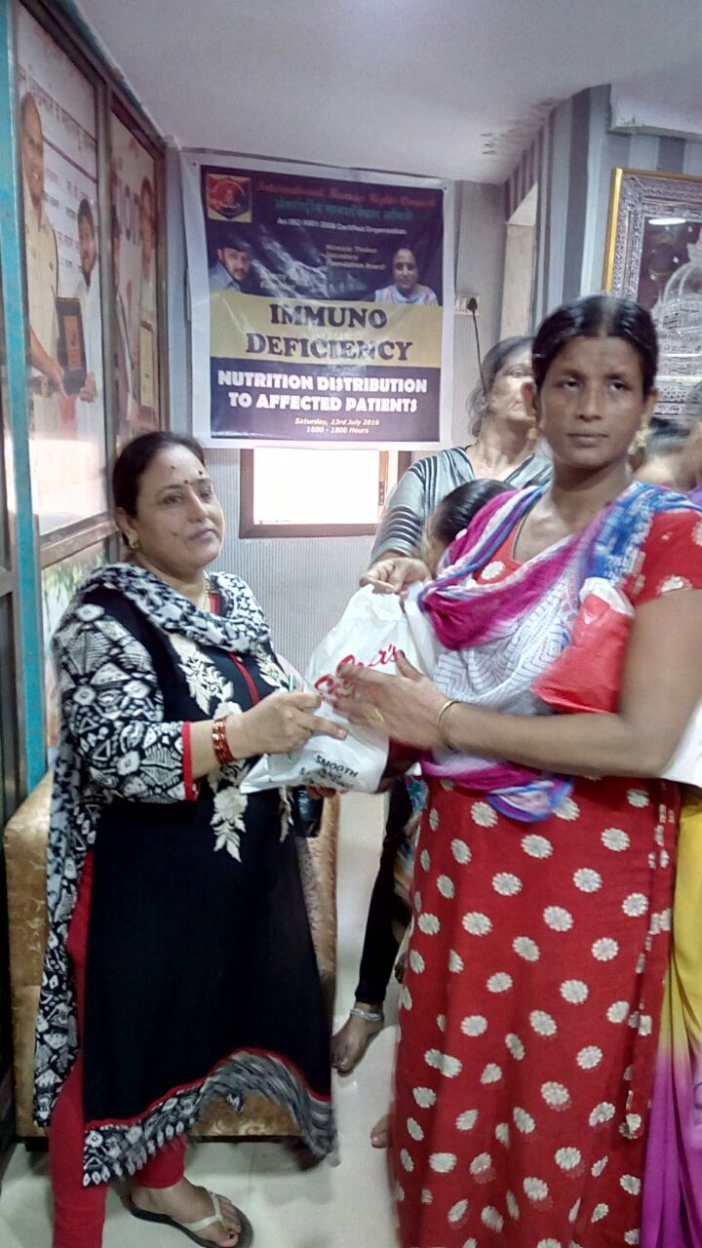
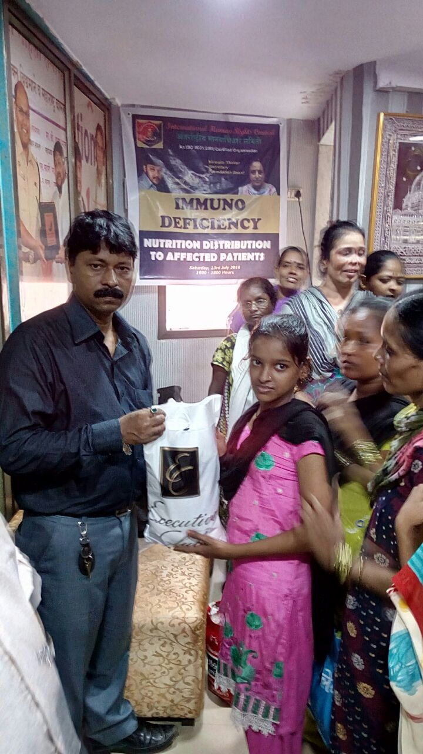

Slide 28
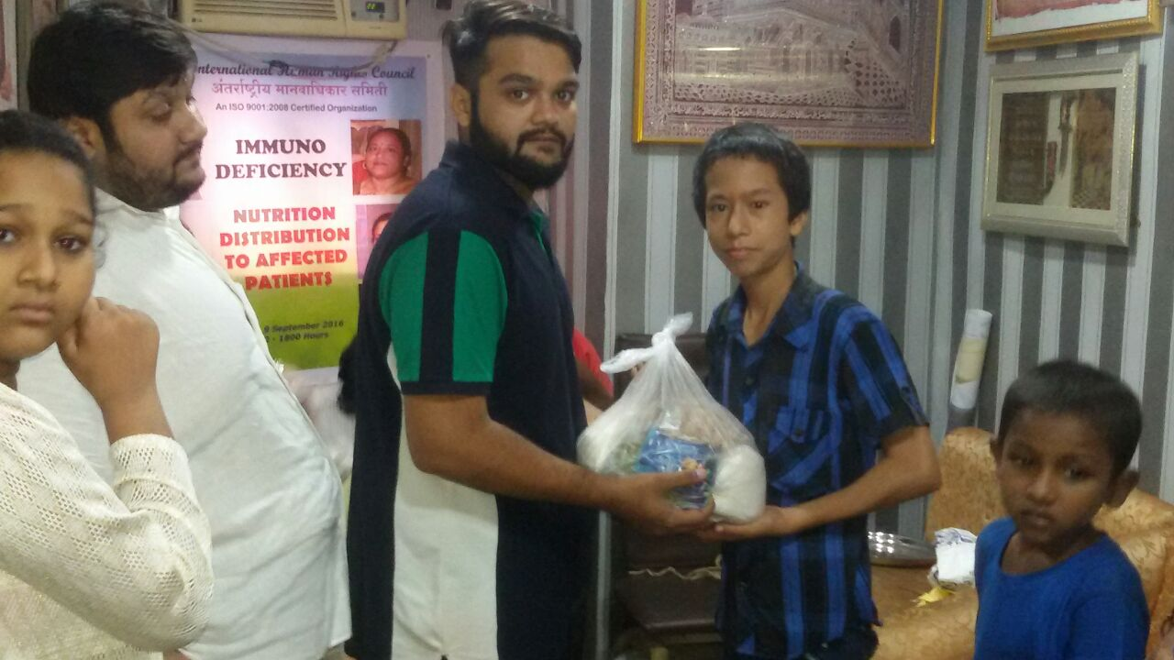

Slide 29
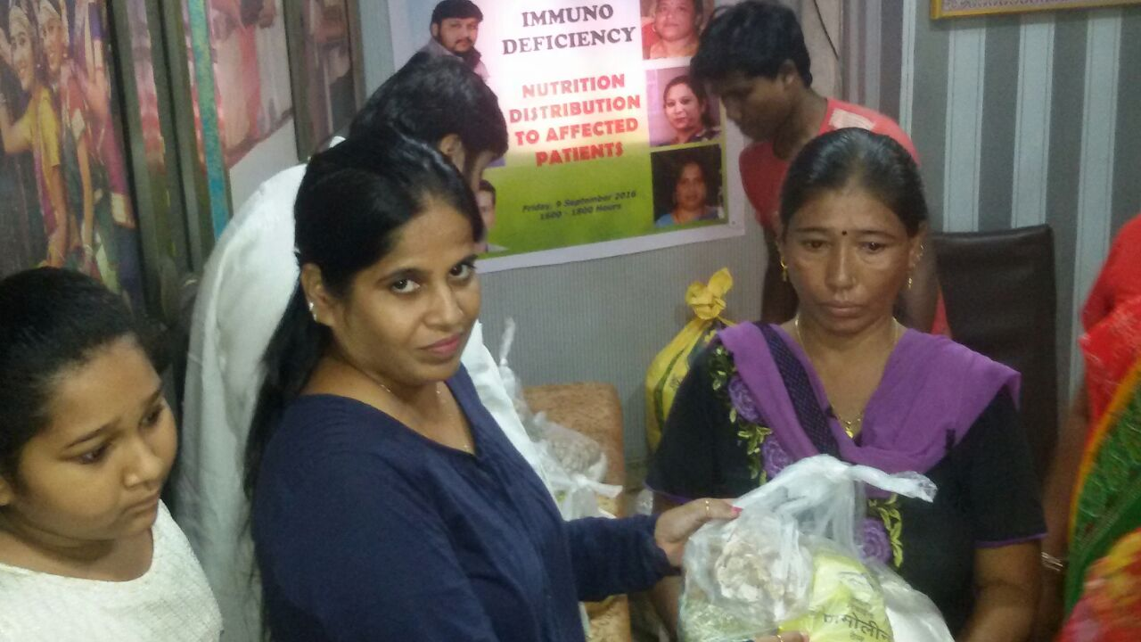

Slide 30
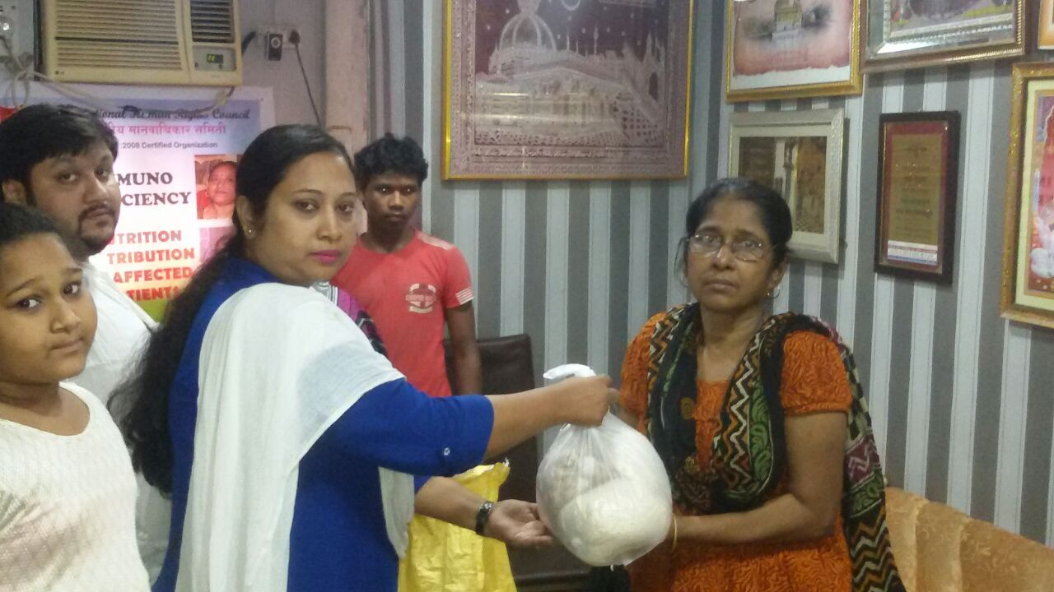

Slide 31
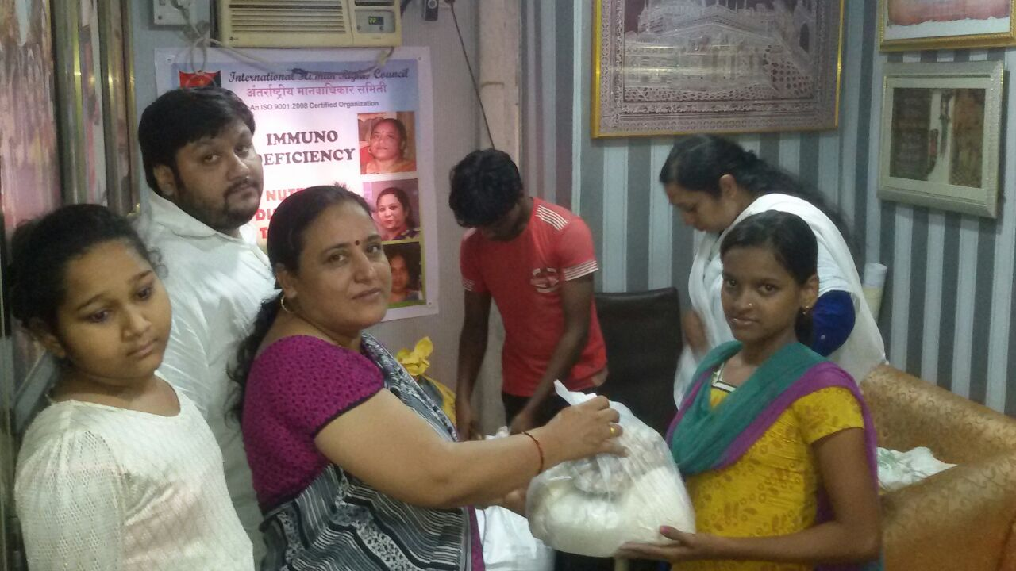

Slide 32
INTERNATIONAL HUMAN RIGHTS COUNCIL
ADMINISTRATION OFFICE
154, Raj Chambers, Alibhai Premji Marg, Grant Road, Mumbai – 400 007
+917208802565, +91 9819122209
+91 9811833865, +91 9823833305
ihrc777@gmail.com
www.ihrc.in

